Slide 1
HHS-CDC Completely Captured ACOG and ‘Fait Accompli’ Rollout of Jab in Pregnancy was Planned Despite Knowledge that it was THE MOST LETHAL Med/Vax/Drug EVER Rolled Out (Pfizer 5.3.6)
James A Thorp MD, Board Certified
ObGyn & Maternal Fetal Medicine
Maggie M Thorp JD
Gulf Breeze, FL April 30, 2023
Twitter @JathorpMFM

Slide 2

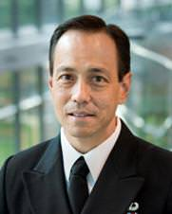
 | James A Thorp MD | Tommy T Shimabukuro MD, MPH
Recommendations for Exp COVID-19 Gene jab in pregnancy | Category X, Contraindicated in Pregnancy, Black Box Warning | Pushed in pregnancy as safe, effective & necessary. He refuses to address Pfizer 5.3.6 documenting 100+ deaths per week (page 7) the most lethal drug ever rolled out. Dec 1 – Feb 28 2021 - 1223 dead after the jab and horrible OB outcomes (page 12) which he knew 2-28-2021.
Specialty | Board Certified Ob/Gyn Board Certified Maternal Fetal Medicine | Family Practice Physician. Board Certified
Cui Bono? | Severely punished, censored and threatened by medical boards | Rewarded with job security for pushing FED narrative. Bonus for being a good vaccine pusher? Other PERCS for pushing the dangerous drug?
Clinical OB Experience | 44 years, 26,000 plus high-risk OB patients in last 4 years alone not including probono patients | Has he EVER seen a pregnant patient? When was the last? How many patients has he seen in the last 3-4 years? Any at all?
Funding Source | Personal time donated; Personal assets donated. | Massive lucrative government grants, support. Supported by Pharma/CDC/FDA
Employer | Large Catholic Healthcare System | Federal Government
Conflicts of Interest (COI) | ZERO. NONE. NADA. Harsh consequences for taking a stand against the state narrative and for pointing out massive death & injury in pregnancy from vax | Massive COI – deeply entrenched in pushing vaccines, Fed Employee, “CDC post-authorization/post-licensure safety monitoring of COVID-19 vaccines”, Vaccine Safety Team of FDA/CDC. Captured by military medical industrial complex
Benefits from Vaccine profits / patent royalties | ZERO. NONE. NADA | CDC/FDA thrive off massive Pharma vaccine dollars & vaccine patent royalties owned by CDC/FDA. Personal holdings of vaccine stocks? Other benefits?
Royalties from books / publications | NONE; 100% Donated; 10+ X book royalties per year donated to charities per year over careerJ | Unknown
Major Pertinent Publication | Journal of American Physicians & Surgeons extensively peer-reviewed. No journal COI. Journal independent of Pharma industrial complex. Article written by authors | NEJM controlled by Pharma, Editor in Chief Eric Rubin pushes the C19 gene jab in children at CDC/FDA hearing admitting no safety data but roll it out and see what happens. Journal dependent upon Pharma industrial complex. Suspect article was Ghostwritten by Pharma
Availability | Answers to all. Willing to debate anyone in the world over the last two years. | Unavailable. No responses. No availability to discuss conflicts of interest or conflicts of safety data. Refuses to disclose all VSAFE data. Refuses to debate.

Slide 3
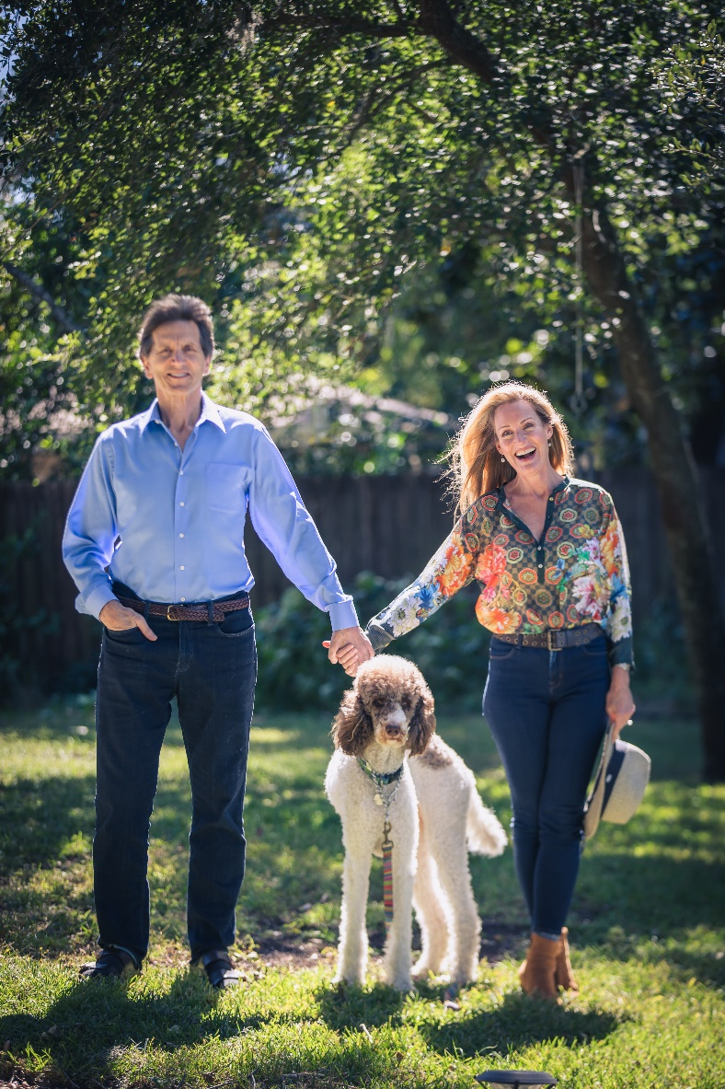
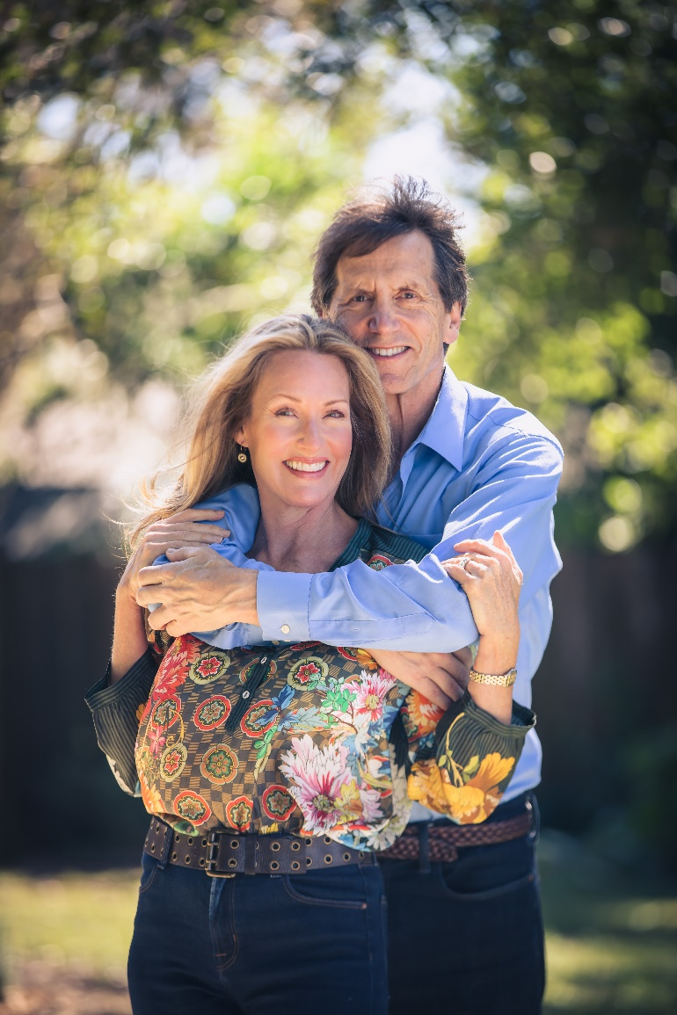

Slide 4
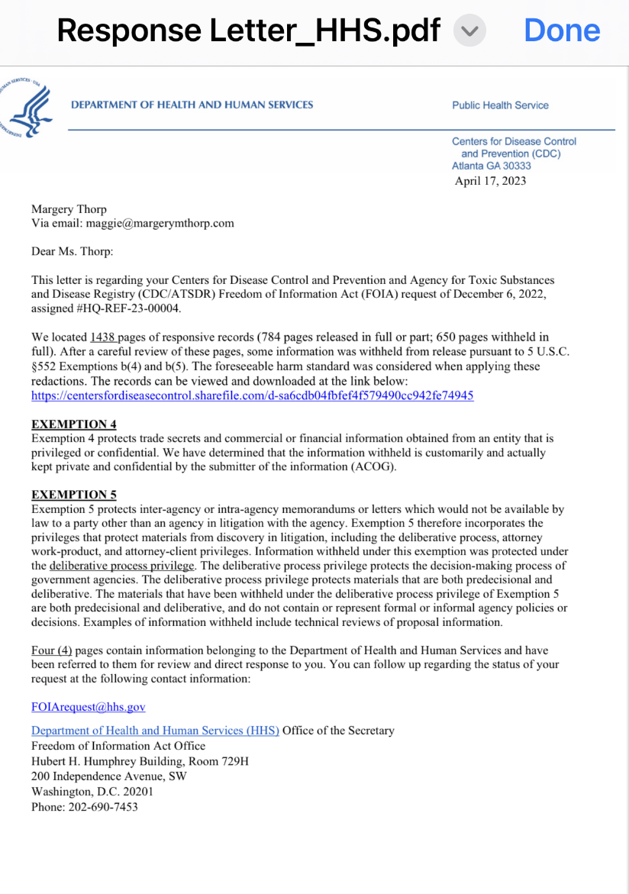
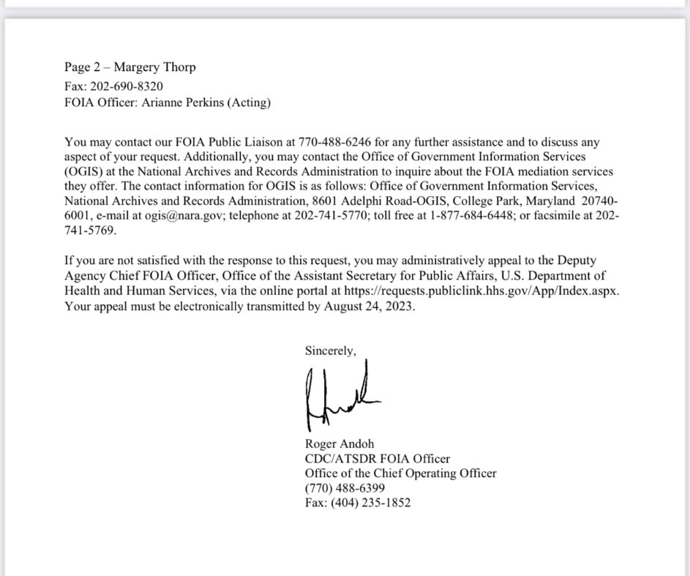

Slide 5
Timeline for “Fait Accompli” Rollout of Jab in Pregnancy
There Was Never Any Safety Data – But Only Danger Data
Begin Pfizer 5.3.6
Dec 1
2020
James A Thorp MD, Maggie M Thorp JD

Slide 6
Timeline for “Fait Accompli” Rollout of Jab in Pregnancy
There Was Never Any Safety Data – But Only Danger Data
Begin Pfizer 5.3.6
End Pfizer 5.3.6
90 day roll out
Dec 1
2020
Feb 28
2021
James A Thorp MD, Maggie M Thorp JD

Slide 7
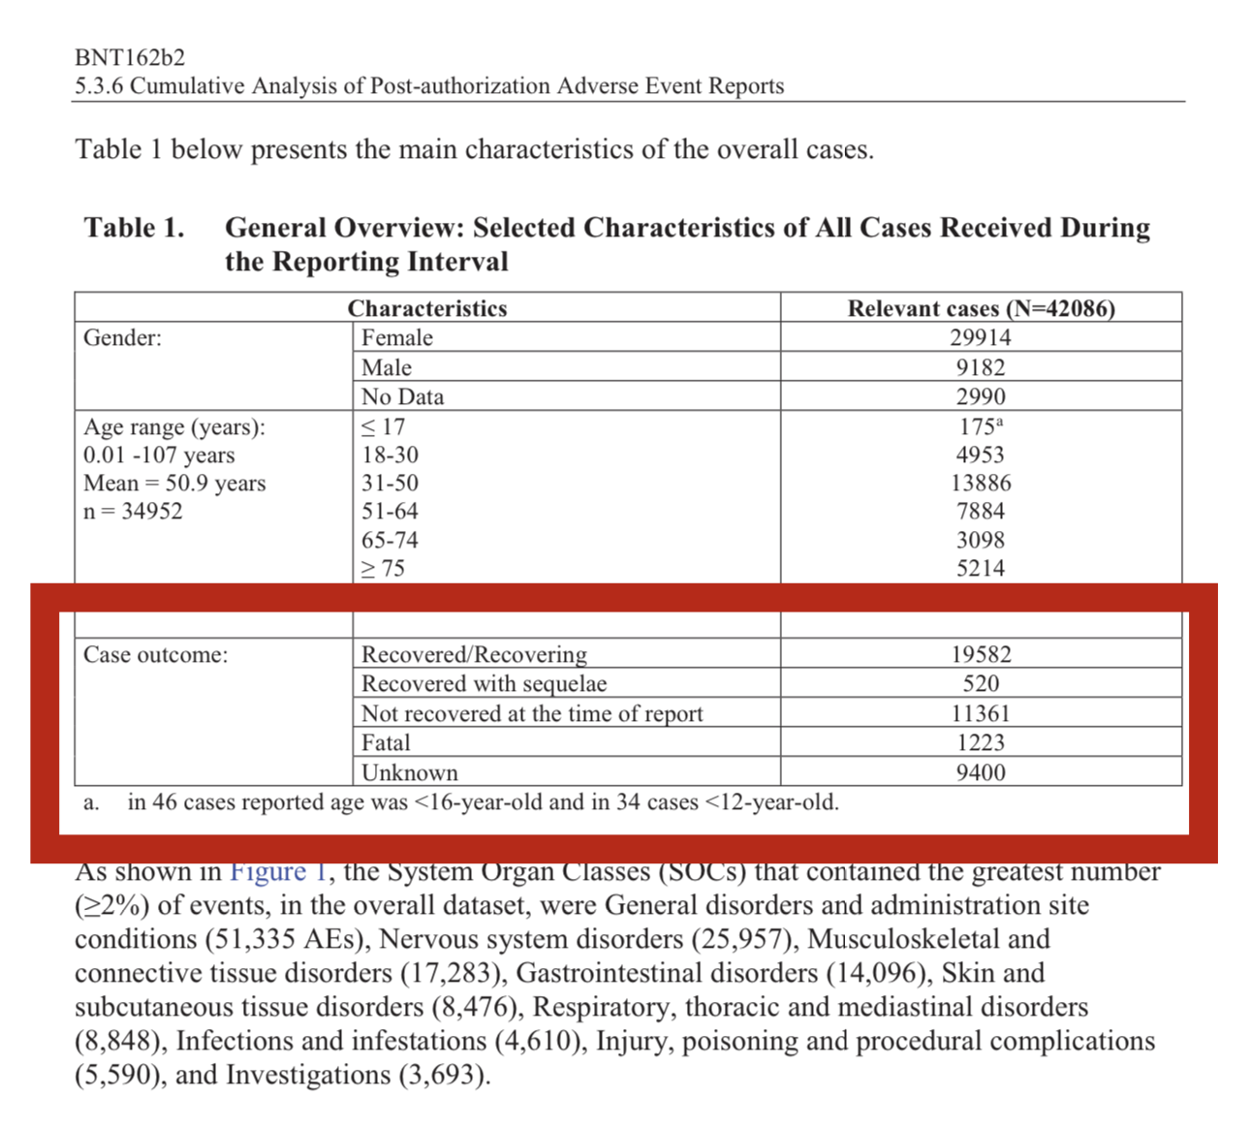




Pfizer 5.3.6 Post-Marketing
Dec 1, 2020 to Feb 28, 2021 (Page 7)
The deadliest vaccine–medicine–drug EVER rolled out in the history of medicine
1,223 deaths in the first 90 days
> 100 deaths per week

Slide 8
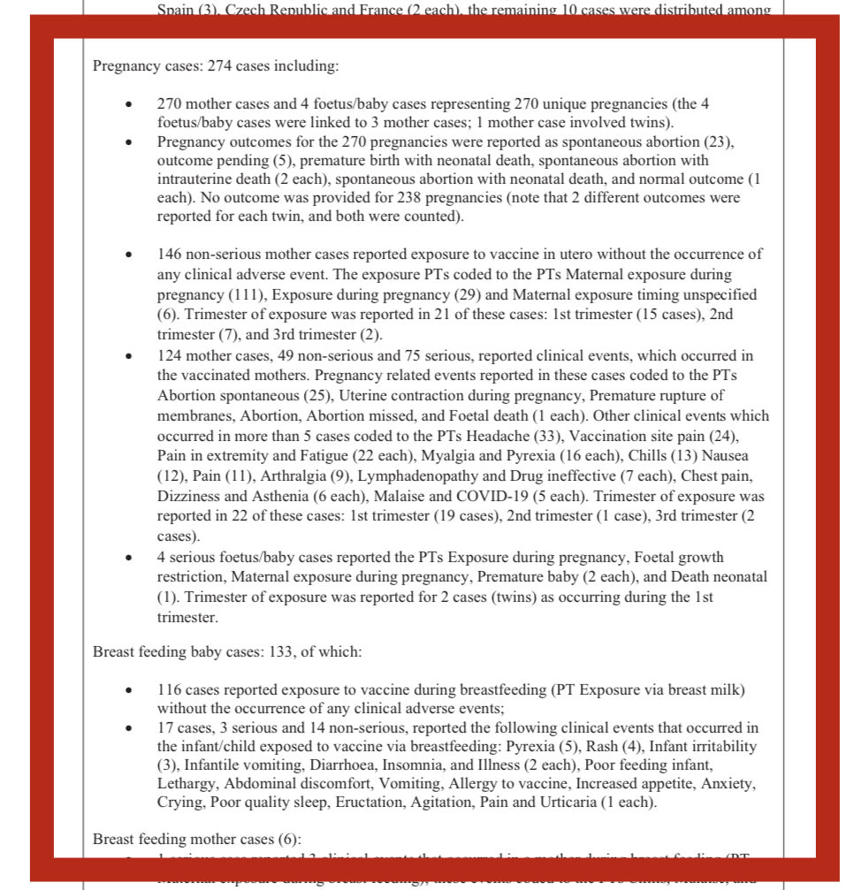







Pfizer 5.3.6 Post-Marketing
Dec 1, 2020 to Feb 28, 2021
Page 12
270 pregnant moms
238/270 had NO follow-up
Only 32 of 270 were followed up to term
124/270 (46%) with jab complications
25/32 with miscarriage aka spont abortion
1/32 “missed abortion” aka miscarriage
26/32 or 81% miscarriage rate
1/32 fetal death equates to stillbirth rate of 31/1000 with expected rate of 5.8/1000
Breastfeeding complications in 17/116 or 14.7% of babies

Slide 9
Timeline for “Fait Accompli” Rollout of Jab in Pregnancy
There Was Never Any Safety Data – But Only Danger Data
HHS CDC $13 Billion funneled thru CCC to ACOG et al
Begin Pfizer 5.3.6
End Pfizer 5.3.6
90 day roll out
Dec 1
2020
Feb 28
2021
March
2021
James A Thorp MD, Maggie M Thorp JD

Slide 10
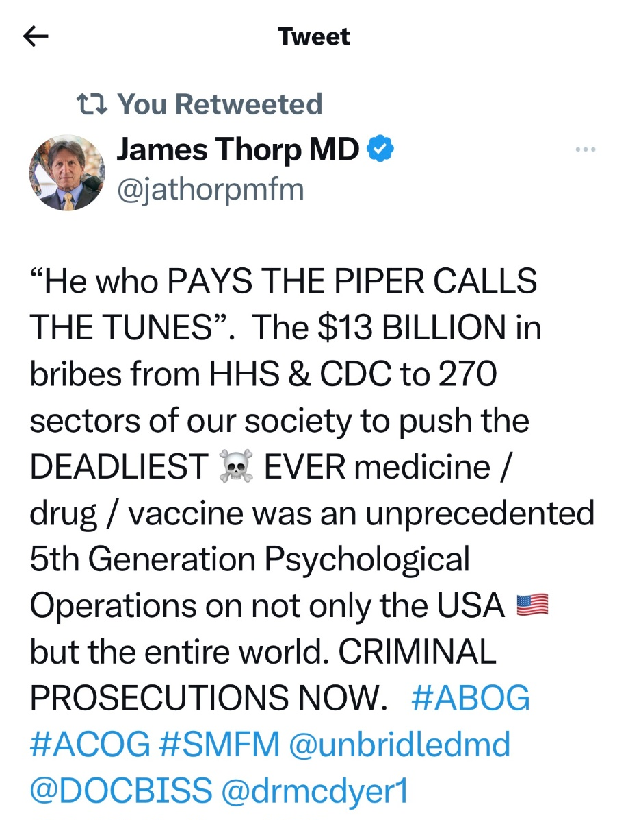
The Largest 5th Generational Psy Ops
Campaign in the History of the World
DOD DARPA BARDA HHS CDC FDA
$13,000,000,000 (Billion with a B)
Qualifies as textbook definition of a BRIBE
275 (298) Sectors of our entire society
Launched only after they knew 2.28.2021 that Pfizer 3.5.6 internal documents proved it to be the most dangerous and deadly drug/medicine/vaccine ever rolled out 122.3 deaths/week in just 10 weeks. Why?
“5 Eyes” USA, Canada, UK, Australia & New Zealand most captured by globalists and most fascist on mandates. Why?

Slide 11
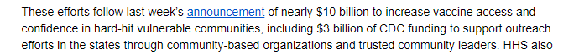
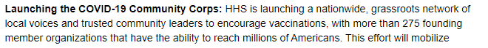




Slide 12
COVID-19 Community Corps
$13 Billion to 298 Sectors of USA Society
Public health & medical organizations: 25/298 (8.5%)
Sports & entertainment: 12/298 (4.4%)
Rural leaders: 25/298 (9.1%)
Unions/organized labor leaders: 25/298 (8.4%)
LatinX leaders: 6/298 (2.0%)
Black leaders: 21/298 (7.0%)
Asian/Pacific Islanders: 15/298 (5.0%)
Native/Tribal leaders: 9/298 (3.0%)
Veterans: 10/298 (3.4%)
Business leaders: 10/298 (3.4%)
Faith leaders: 87/298 (29.2%)
Community leaders: 53/298 (17.8%)

Slide 13
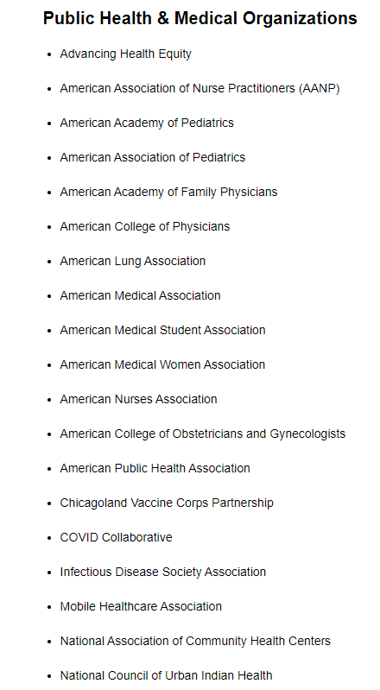
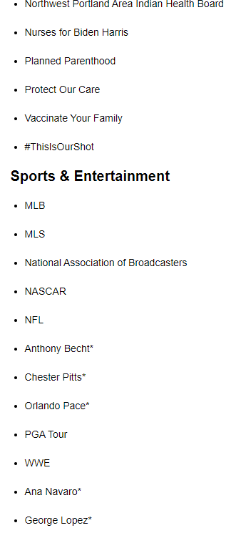
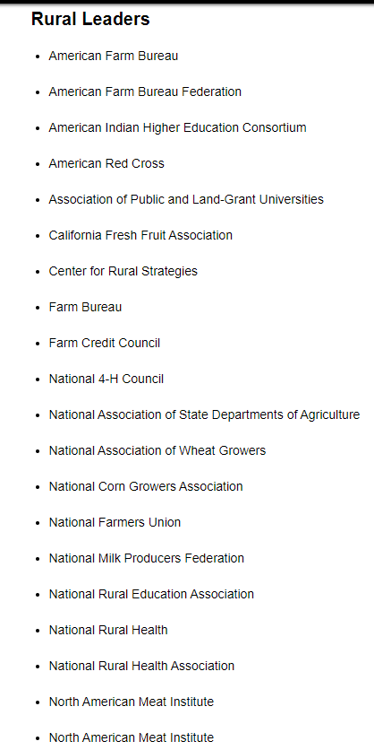
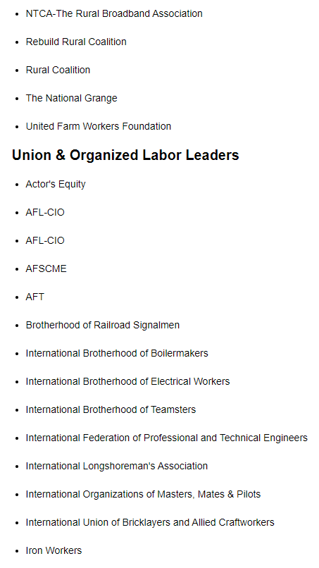
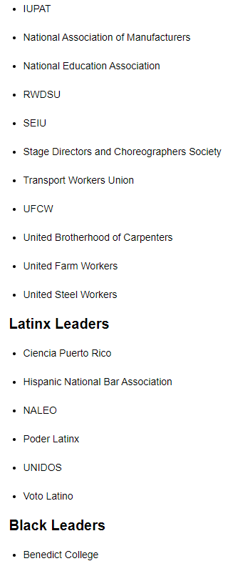
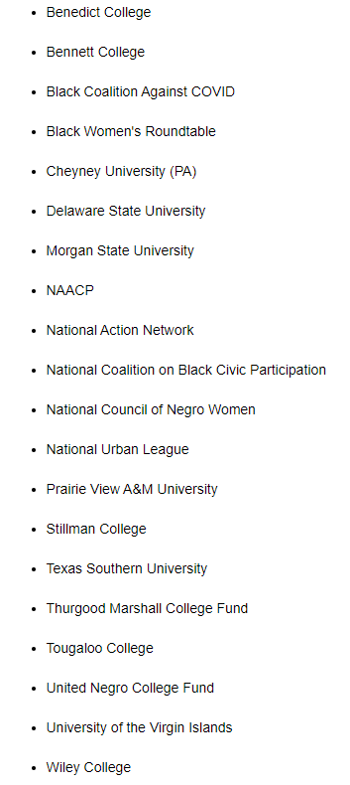
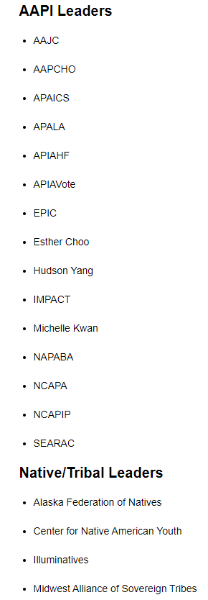
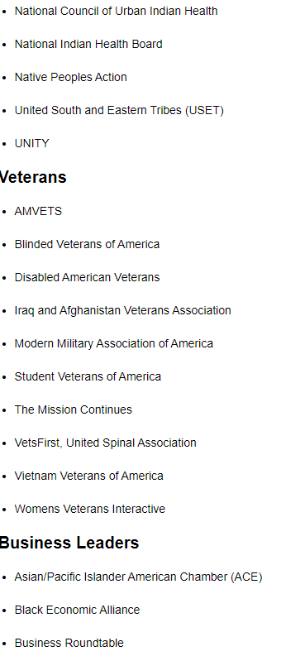
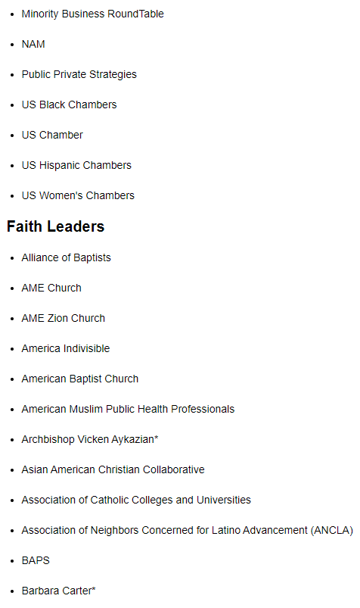
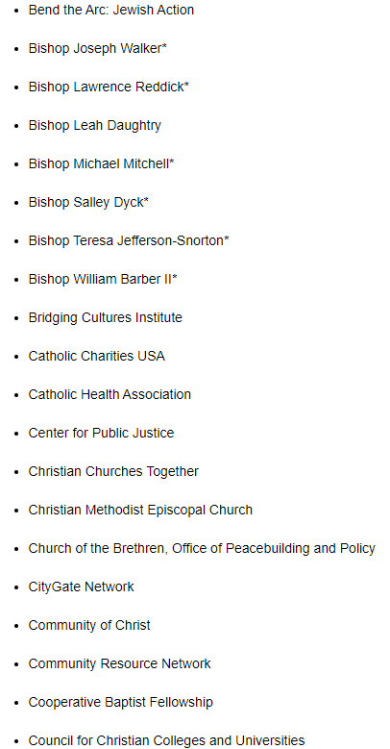
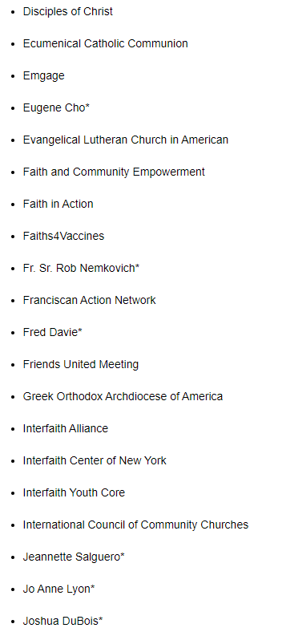
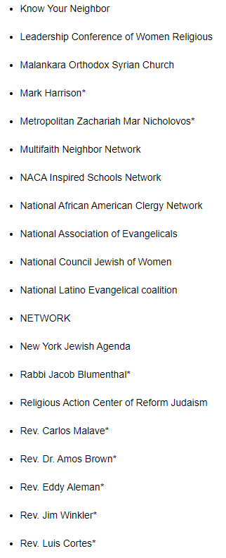
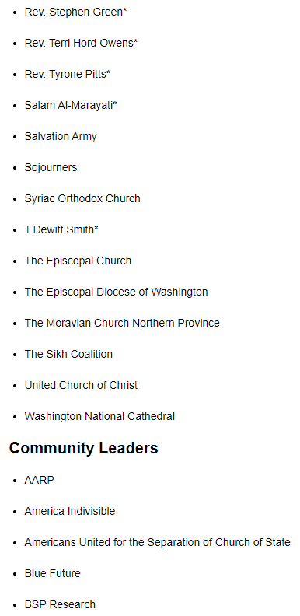
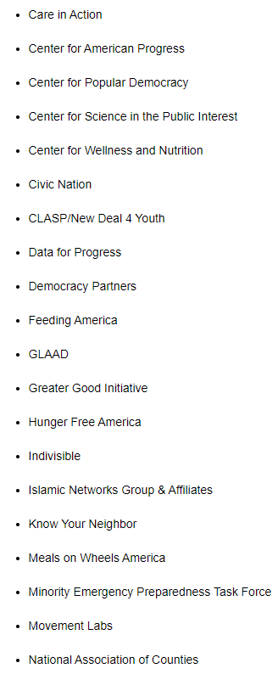
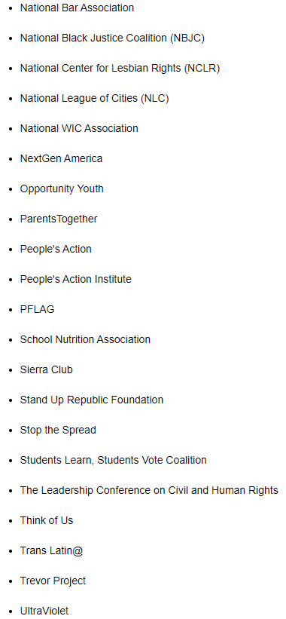
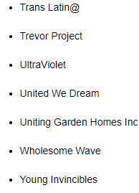

















Slide 14
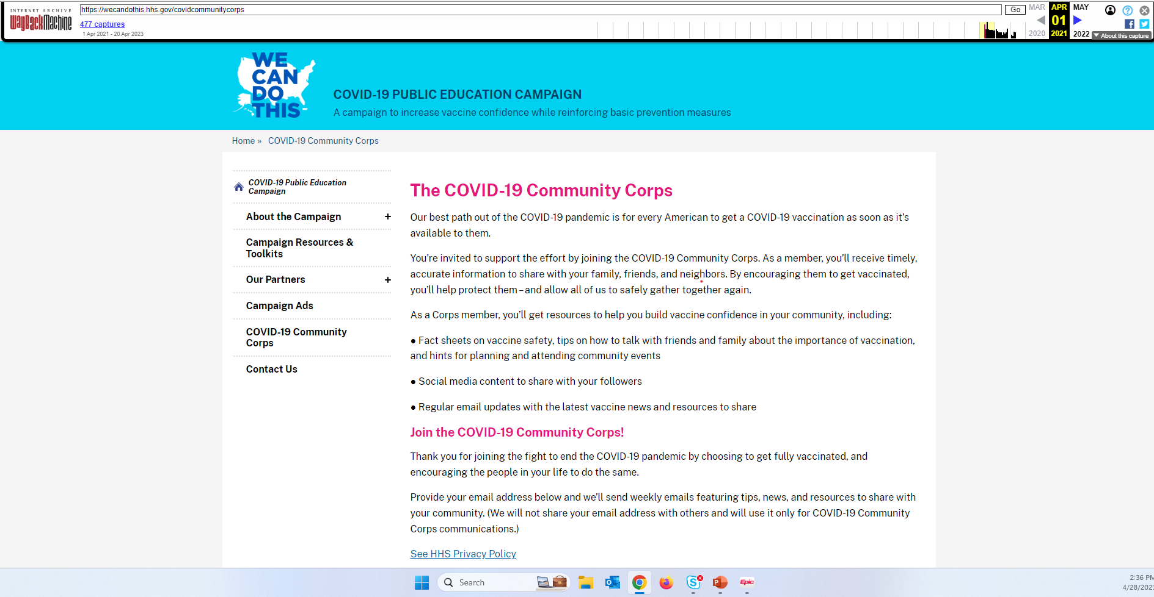

Slide 15
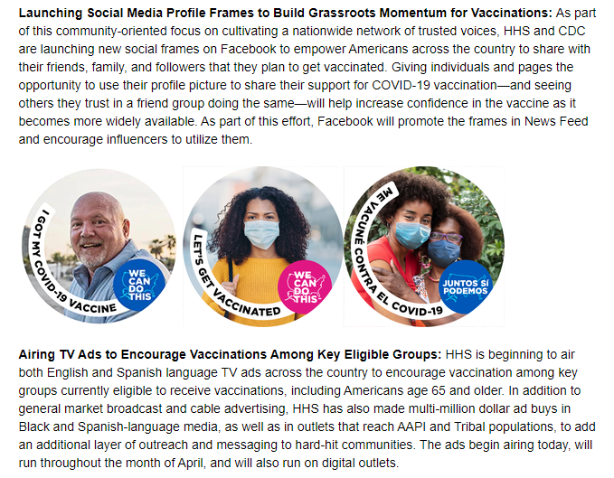









Slide 16
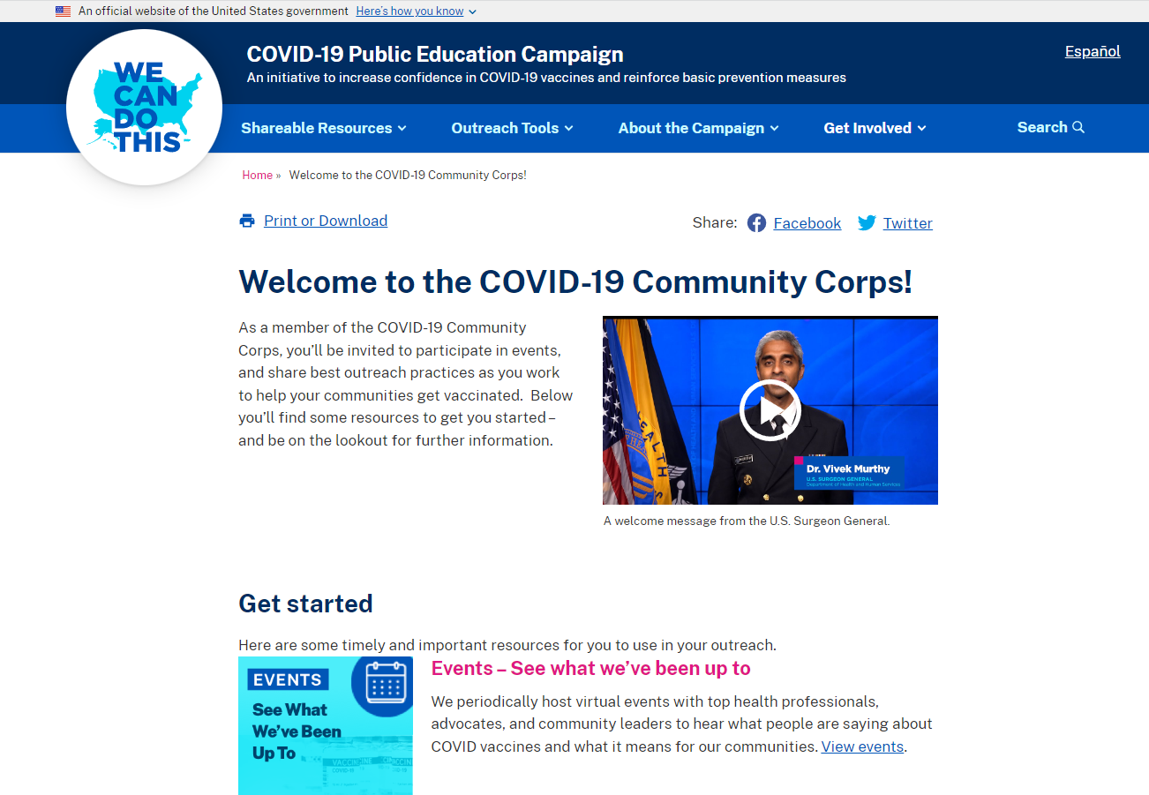

Slide 17
Timeline for “Fait Accompli” Rollout of Jab in Pregnancy
There Was Never Any Safety Data – But Only Danger Data
NEJM Shimabukuro pushing Jab in Pregnancy VSafe1
HHS CDC $13 Billion funneled thru CCC to ACOG et al
Begin Pfizer 5.3.6
End Pfizer 5.3.6
90 day roll out
Dec 1
2020
Feb 28
2021
March
2021
June 17
2021
James A Thorp MD, Maggie M Thorp JD

Slide 18
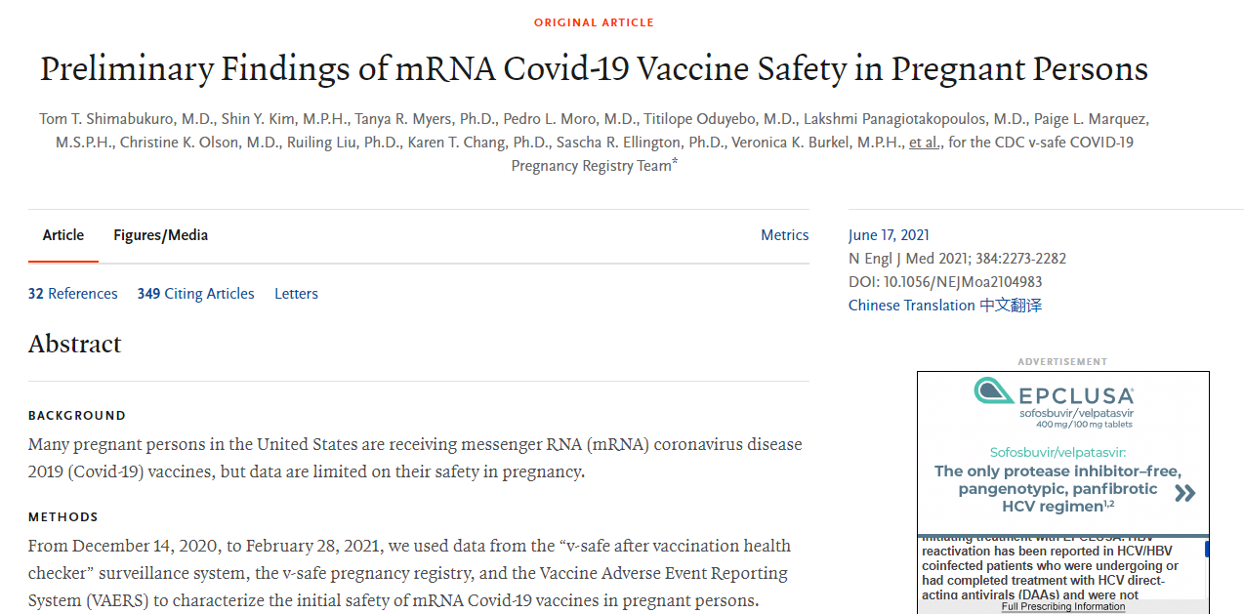









Slide 19
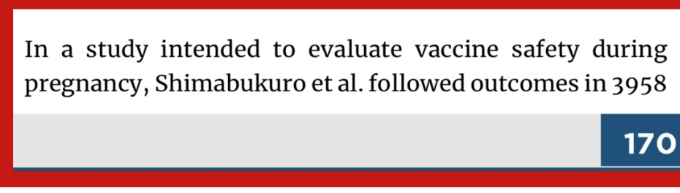
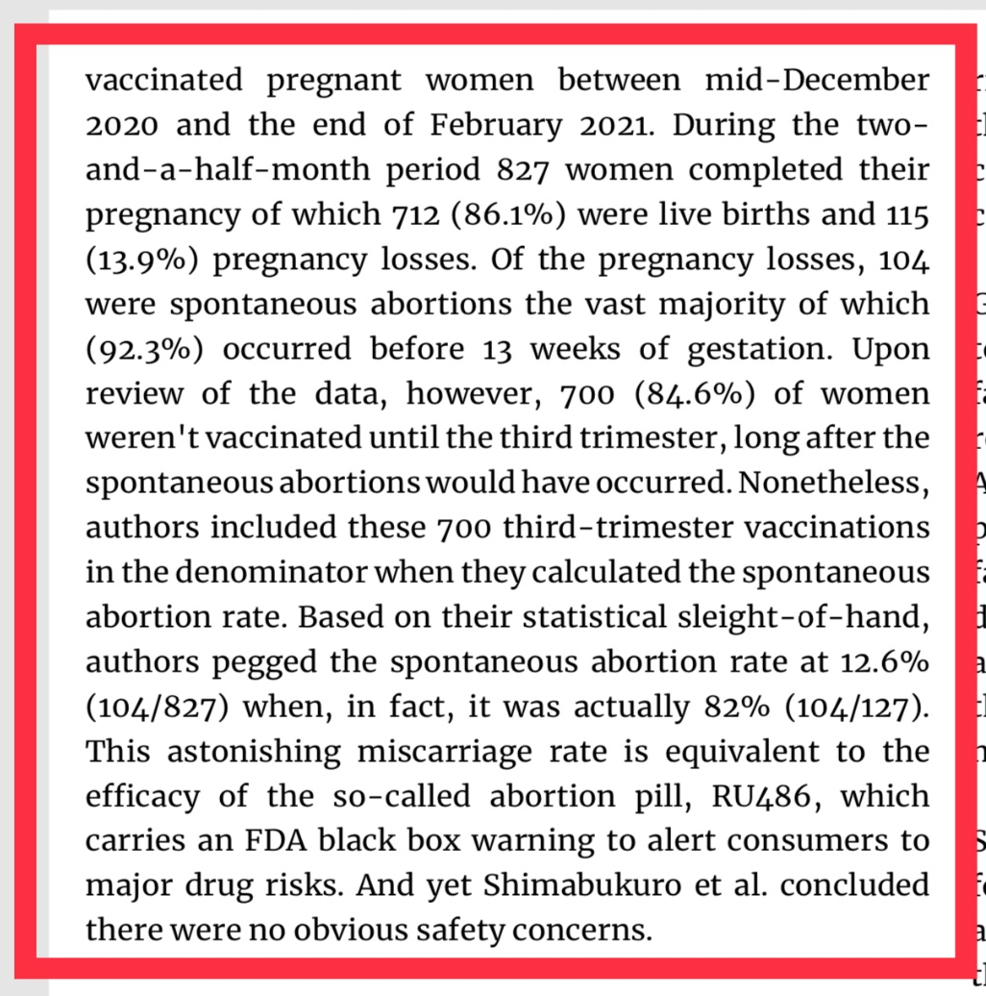
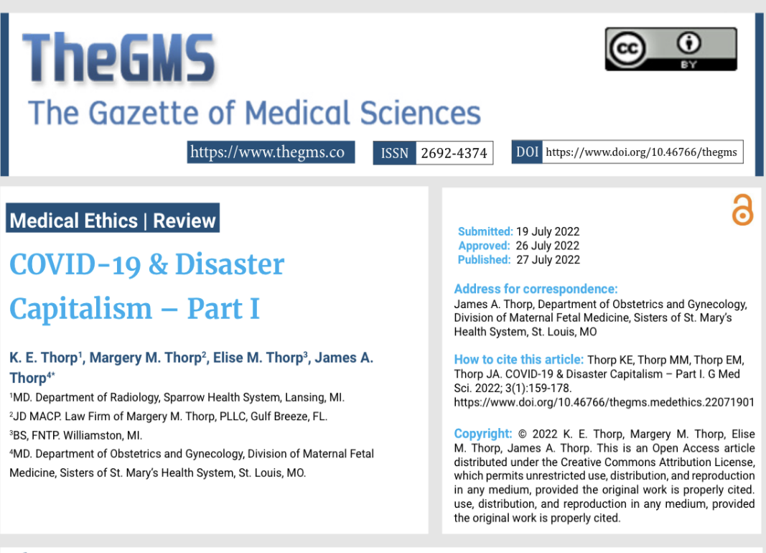












Slide 20
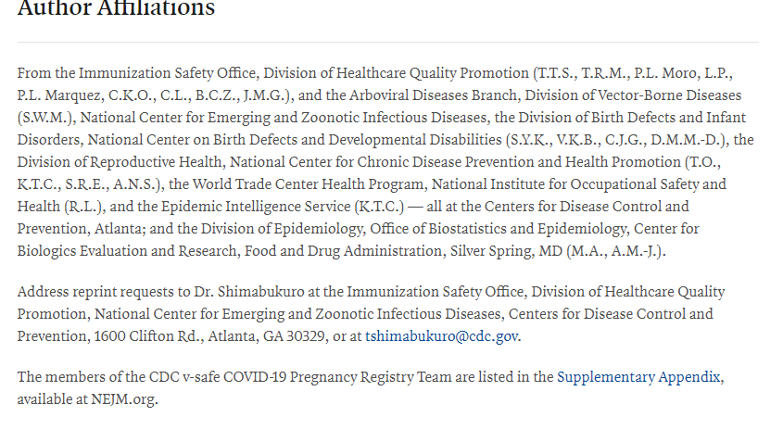
Shimabukuro et al. Preliminary Findings
of mRNA COVID-19 Vaccine Safety in
Pregnant Persons. NEJM June 17, 2021
384:2273-2282
All 21 Authors are Federal Employees and the article appears to be ghost written by Pfizer
Only had 10 weeks of study with pregnancy lasting 40 weeks; Vsafe phone app system used
Shimabukuro deeply entrenched in pushing vaccines; he heads the “CDC post-authorization/post-licensure safety monitoring of COVID-19 vaccines” of CDC FDA; Vaccine Safety Team of FDA/CDC.
Complete Capture by military medical industrial complex (MMIC) including Pharma
Pushes safety of jab in the pregnancy knowing of very dangerous data from Pfizer 5.3.6 .
Deceptively manipulated miscarriage rate from 82% to 13%
Woke language in the title – pay attention to details. If they cannot accurately describe pregnancy as NON-inclusive in women how can you trust their data interpretation?

Slide 21
Timeline for “Fait Accompli” Rollout of Jab in Pregnancy
There Was Never Any Safety Data – But Only Danger Data
NEJM Shimabukuro pushing Jab in Pregnancy VSafe1
HHS CDC $13 Billion funneled thru CCC to ACOG et al
Begin Pfizer 5.3.6
End Pfizer 5.3.6
90 day roll out
ACOG ABOG & SMFM Push Jab in Pregnancy
Dec 1
2020
Feb 28
2021
March
2021
June 17
2021
July 6
2021
James A Thorp MD, Maggie M Thorp JD

Slide 22
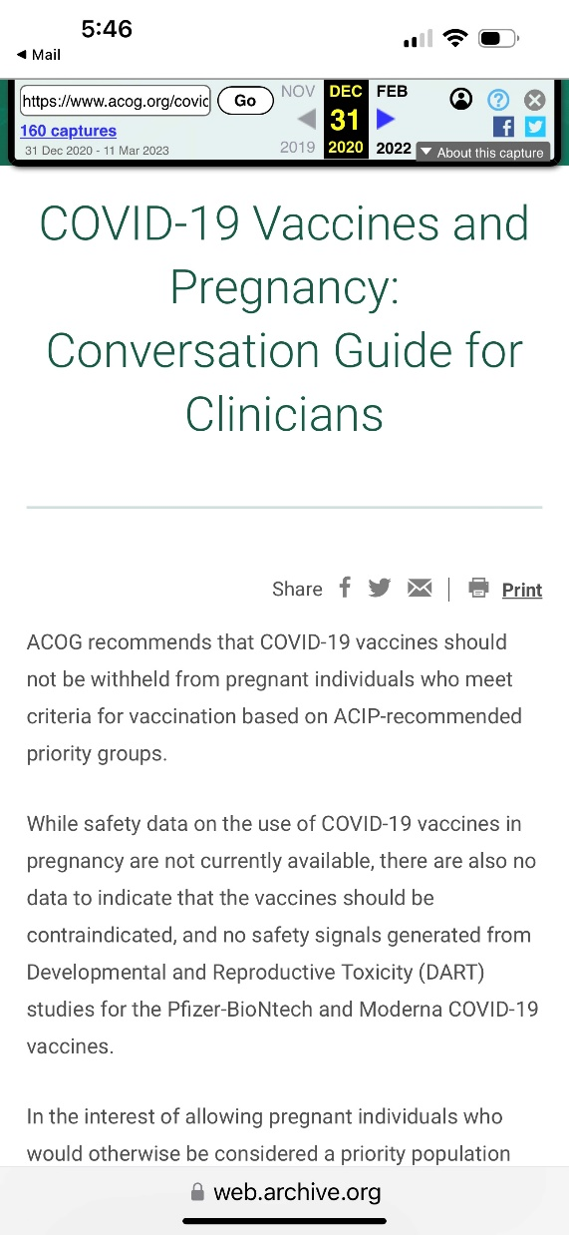
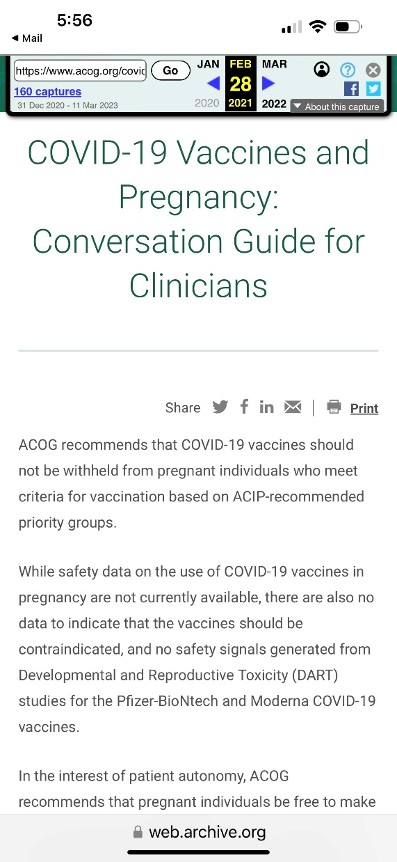
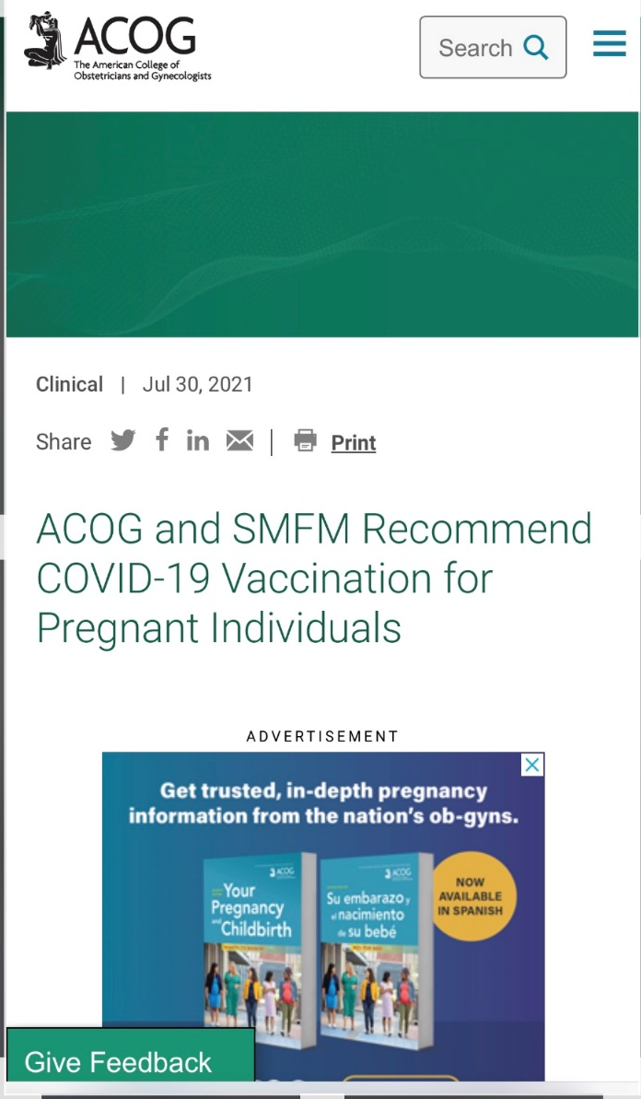

Slide 23
Timeline for “Fait Accompli” Rollout of Jab in Pregnancy
There Was Never Any Safety Data – But Only Danger Data
NEJM Shimabukuro pushing Jab in Pregnancy VSafe1
HHS CDC $13 Billion funneled thru CCC to ACOG et al
ACOG, ABOG, SMFM, & 100+ medical organizations & societies threaten all Docs & Nurses with loss of credentials & licenses for spreading “COVID misinformation”
Begin Pfizer 5.3.6
End Pfizer 5.3.6
90 day roll out
ACOG ABOG & SMFM Push Jab in Pregnancy
Dec 1
2020
Feb 28
2021
March
2021
June 17
2021
July 6
2021
Sept
2021
James A Thorp MD, Maggie M Thorp JD

Slide 24
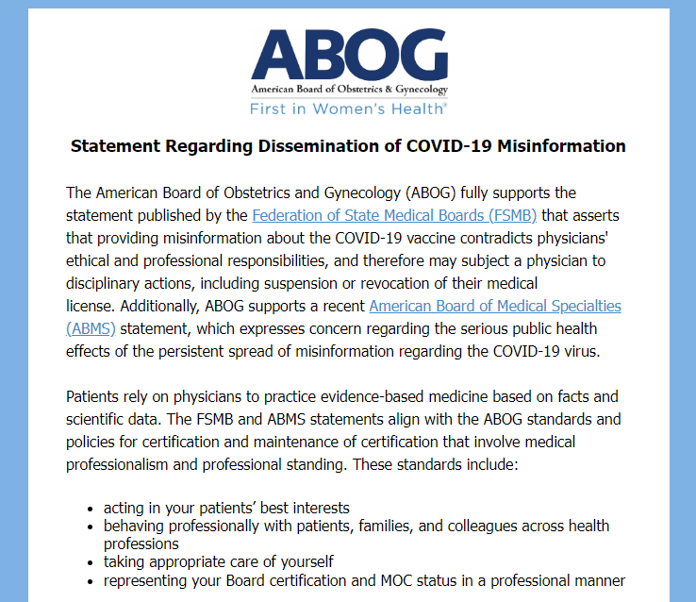
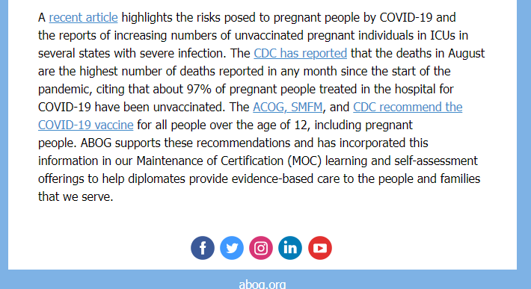





The ABOG EMAIL Sent to ALL
Constituents September 2021

Slide 25
Timeline for “Fait Accompli” Rollout of Jab in Pregnancy
There Was Never Any Safety Data – But Only Danger Data
NEJM Zauche Pushing the Jab in Pregnancy Vsafe2
NEJM Shimabukuro pushing Jab in Pregnancy VSafe1
HHS CDC $13 Billion funneled thru CCC to ACOG et al
ACOG, ABOG, SMFM, & 100+ medical organizations & societies threaten all Docs & Nurses with loss of credentials & licenses for spreading “COVID misinformation”
Begin Pfizer 5.3.6
End Pfizer 5.3.6
90 day roll out
ACOG ABOG & SMFM Push Jab in Pregnancy
Dec 1
2020
Feb 28
2021
March
2021
June 17
2021
July 6
2021
Sept
2021
October
2021
James A Thorp MD, Maggie M Thorp JD

Slide 26
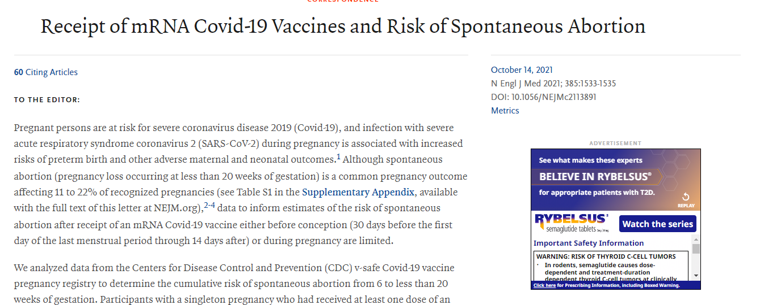


Res Ipsi Loquitor: New England Journal of Medicine is CORRUPTED. Pharma & Woke Captured Flagship Journal of the Medical Military Industrial Complex with Editor in Chief Eric Rubin MD. He voted to push mRNA vaccines in children at the FDA 2022: “we have no safety data, we just need to roll it out and see what happens”. Myocarditis Pericarditis rises from 2/million to 25,000/million. No apology. Thanks Rubin

Slide 27

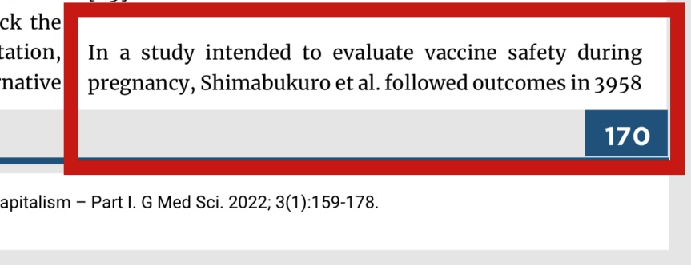
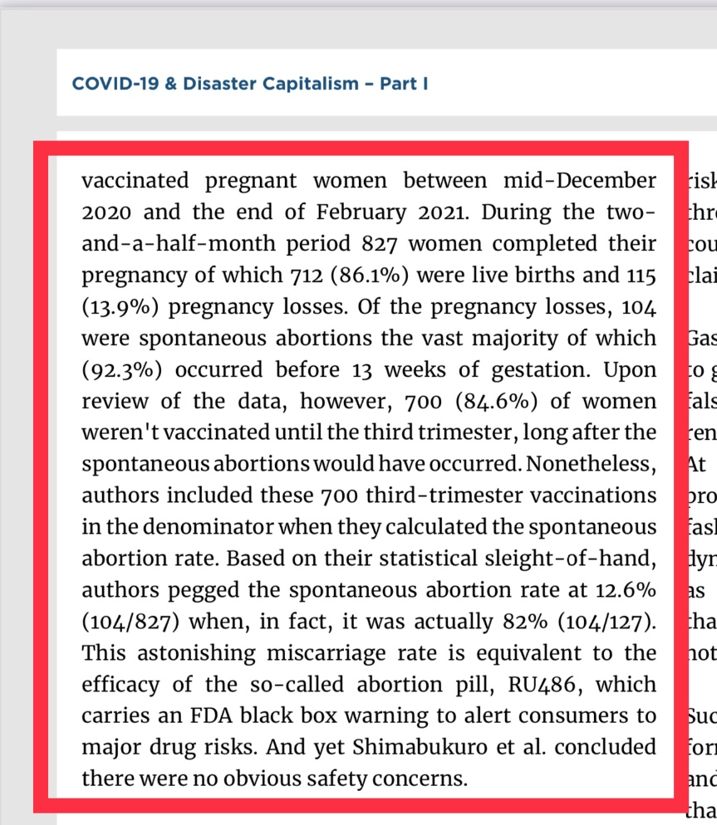










Slide 29
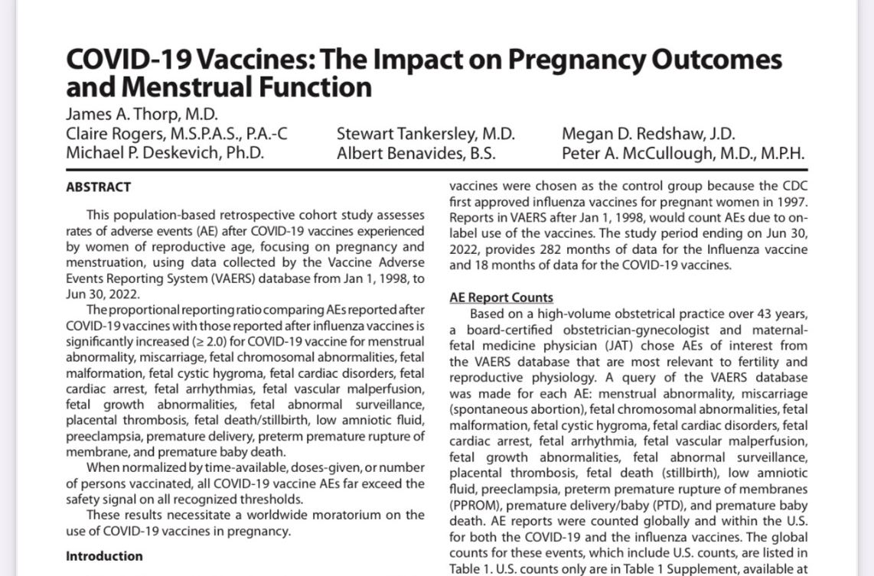



Slide 30
Thank You

Slide 31
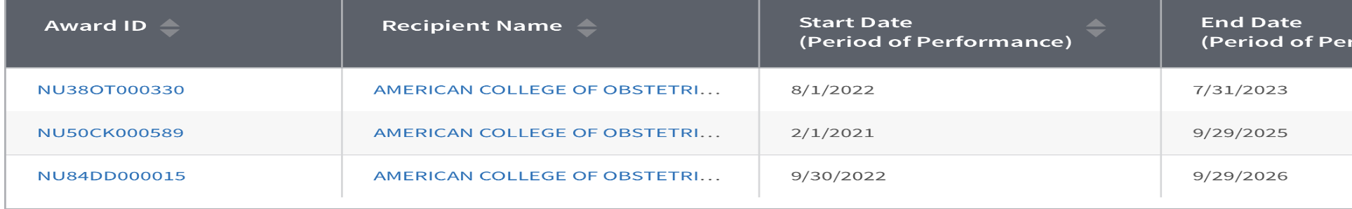
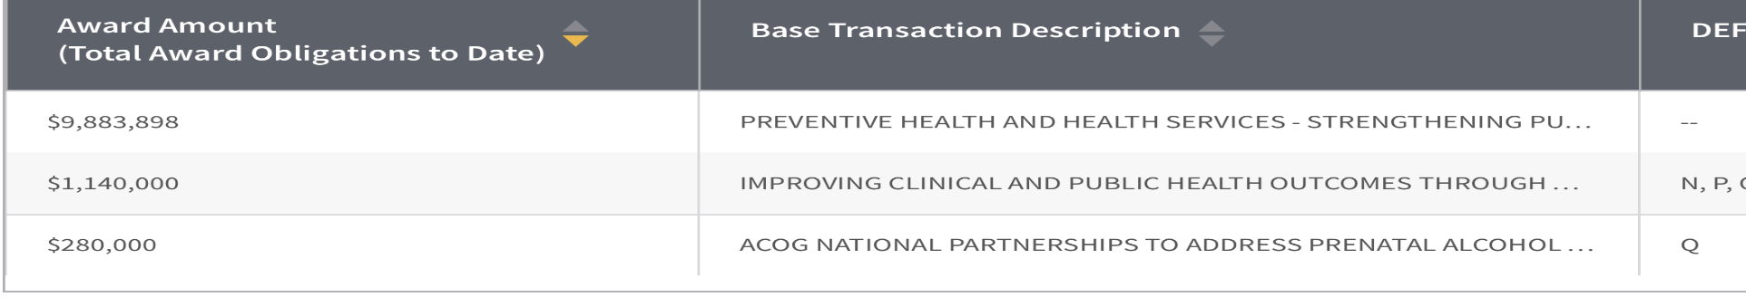
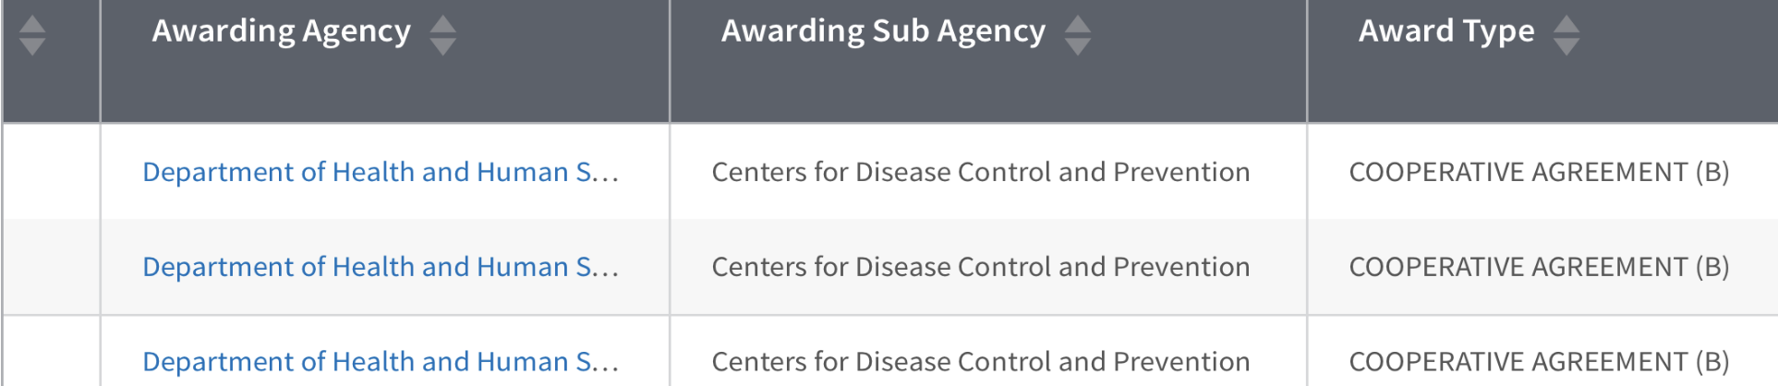

Slide 32
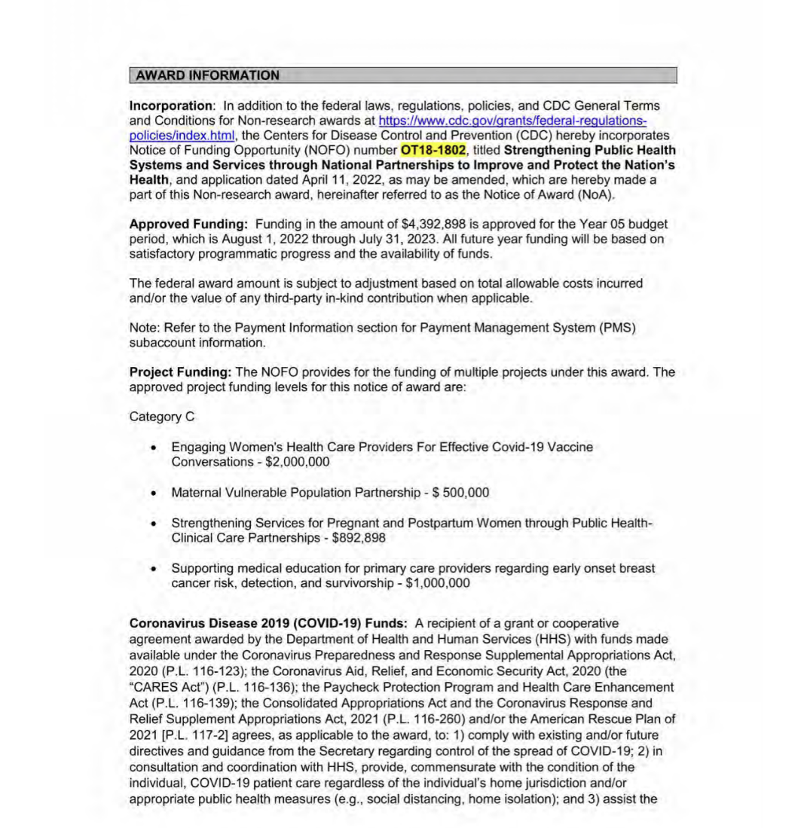
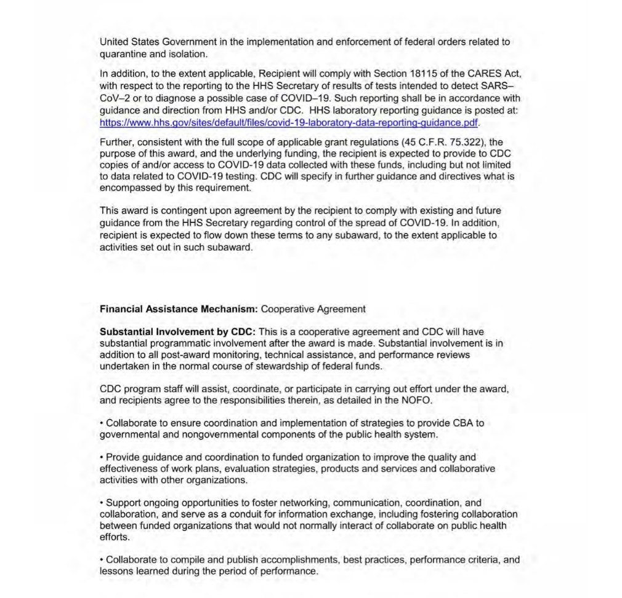

Slide 33
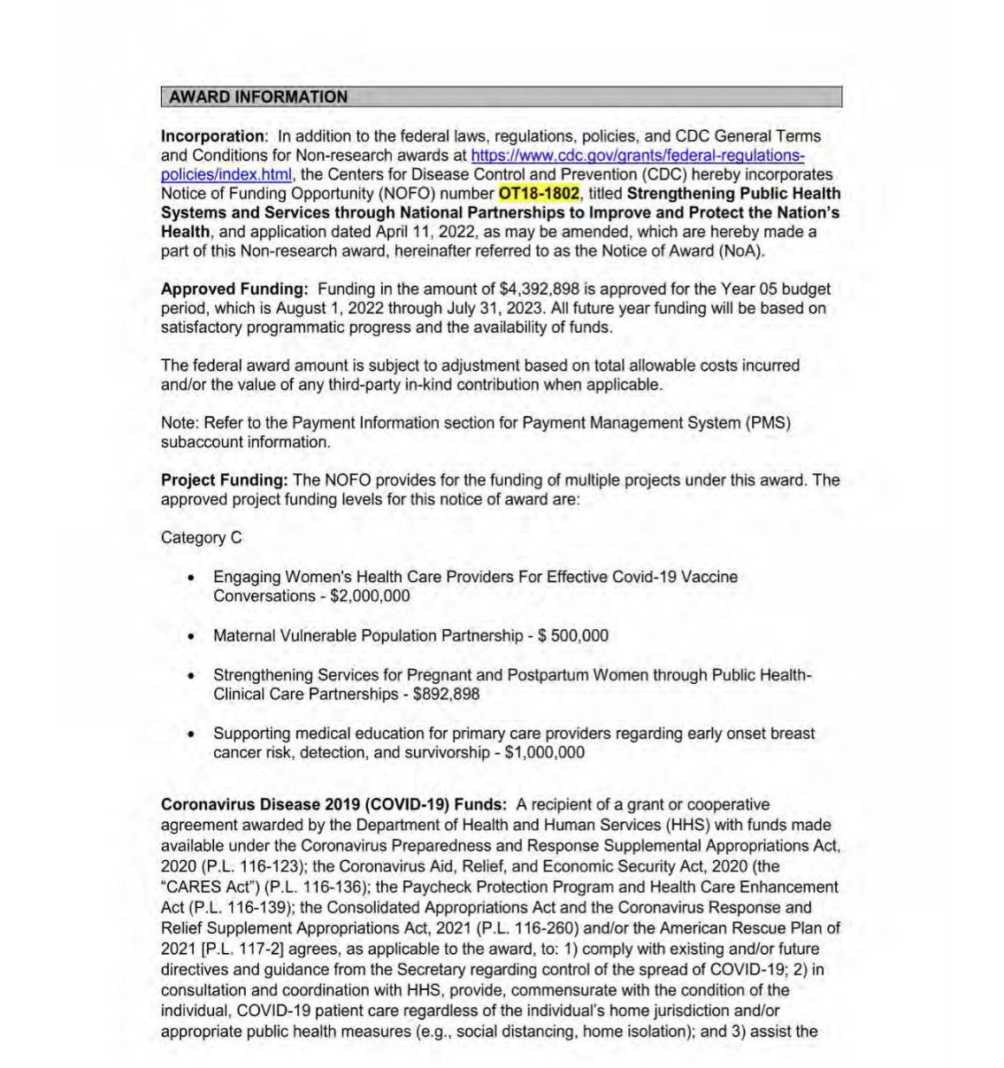

Slide 34
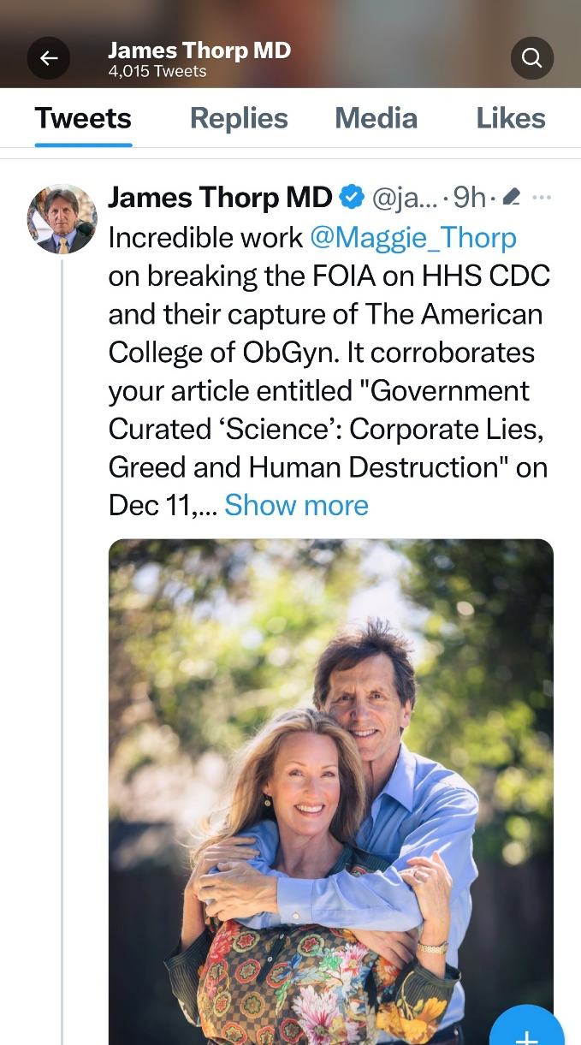


Slide 35
COVID-19 Vaccines and the Impact on Pregnancy Outcomes and Menstrual Function
James A Thorp MD ObGyn & Maternal Fetal Medicine, Gulf Breeze, FL
Claire Rogers, MSPAS, PA-C, Rome, GA
Michael P Deskevich, PhD Modeling and Simulation, Boulder, CO
Stewart Tankersley MD, Montgomery, AL
Albert Benavides BS, San Jose, CA
Megan D Redshaw JD, Palmyra, MO
Peter A. McCullough MD, MPH, Dallas, TX

Slide 36


Slide 37

34 Independent Sources Collaborating VAERS C19 Vax Injury
UK government
UK Yellow card
EMA EudraVigillance
WHO VigiAccess
61,000 dead millennials
OneAmerica Insurance
Lincoln insurance
80 Canadian physicians DEAD
Avalanche of 769 Athletes dropping dead
All Cause mortality way up
Palmer & Bhadki confirm C19 vax deaths by autopsy
Dr. Arne Burkhardt
Alexandra Latypova
Embalmers Richard Hirschman et al
Canadian stillbirths
California stillbirths
Birth rates down globally about 10% per government data
CV9 country’s vax rates correlate with C19 deaths
Dr. Daniel Nagase, Canada
Dr. Peter McCullough
DMED US Military database Dr. Theresa Long
World Council for Health
Spiro Pantazatos MD MPH
1,366 AE med journal publications in 15 months
Costa Rica
Scandinavian Countries
Uruguay
Germany
Italy
Romania
CV19 vaccine: miscarriage, fertility, fetal deaths
78 countries in world have dropped mandates
Steve Kirsch formal questionnaire
Pfizer 5.3.6 post-marketing analysis

Slide 38








COVID-19 and the Unraveling of Experimental Medicine – Part III
Appendix 1 Continued Below
Thorp KE, Thorp JA, Thorp EM. COVID-19 and the Unraveling of Experimental Medicine - Part III. G Med Sci. 2022; 3(1):118-158. https://www.doi.org/10.46766/thegms.pubheal.22042302

Slide 39
Peer-Reviewed Medical Journal Publications
Documenting Severe Injury or Death after Vaccination:
COVID-19 Vaccines (15 months) versus Other Vaccines
3
COVID-19
Vaccines
15 Months
Influenza
Vaccines
784 Months
MMR
Vaccines
616 Months
Hepatitis B
Vaccines
484 Months
TDAP
Vaccines
436 Months
Varicella
Vaccines
448 Months
Meningococcal
Vaccines
556 Months
Thorp KE, Thorp JA, Thorp EM. COVID-19 and the Unraveling of Experimental Medicine - Part III.
G Med Sci. 2022; 3(1):118-158. https://www.doi.org/10.46766/thegms.pubheal.22042302

Slide 40


Slide 41


Slide 42
 | James A Thorp MD
Recommendations for Exp COVID-19 Gene jab in pregnancy | Category X, Contraindicated in Pregnancy, Black Box Warning
Specialty | Board Certified Ob/Gyn Board Certified Maternal Fetal Medicine
Cui Bono? | Severely punished, censored and threatened by medical boards
Clinical OB Experience | 44 years, 26,000 plus high-risk OB patients in last 4 years alone not including pro bono patients
Funding Source | Personal time donated; Personal assets donated.
Employer | Large Catholic Healthcare System
Conflicts of Interest (COI) | ZERO. NONE. NADA. Harsh consequences for taking a stand against the state narrative and for pointing out massive death & injury in pregnancy from vax
Benefits from Vaccine profits / patent royalties | ZERO. NONE. NADA.
Royalties from books / publications | NONE; 100% Donated; 10+ X book royalties per year donated to charities over career
Major Pertinent Publication | Journal of American Physicians & Surgeons extensively peer-reviewed. No journal COI. Journal independent of Pharma industrial complex. Article written by authors
Availability | Answers to all. Willing to debate anyone in the world over the last two years.

Slide 43
 | Tommy T Shimabukuro MD, MPH
Recommendations for Exp COVID-19 Gene jab in pregnancy | Pushed in pregnancy as safe, effective & necessary. He refuses to address Pfizer 5.3.6 documenting 100+ deaths per week (page 7) the most lethal drug ever rolled out. Dec 1 – Feb 28 2021 - 1223 dead after the jab and horrible OB outcomes (page 12) which he knew 2-28-2021.
Specialty | Family Practice Physician. Board Certified
Cui Bono? | Rewarded with job security for pushing FED narrative. Bonus for being a good vaccine pusher? Other PERCS for pushing the dangerous drug?
Clinical OB Experience | Has he EVER seen a pregnant patient? When was the last? How many patients has he seen in the last 3-4 years? Any at all?
Funding Source | Massive lucrative government grants, support. Supported by Pharma/CDC/FDA
Employer | Federal Government
Conflicts of Interest (COI) | Massive COI – deeply entrenched in pushing vaccines, Fed Employee, “CDC post-authorization/post-licensure safety monitoring of COVID-19 vaccines”, Vaccine Safety Team of FDA/CDC. Captured by military medical industrial complex
Benefits from Vaccine profits / patent royalties | CDC/FDA thrive off massive Pharma vaccine dollars & vaccine patent royalties owned by CDC/FDA. Personal holdings of vaccine stocks? Other benefits?
Royalties from books / publications | Unknown
Major Pertinent Publication | NEJM controlled by Pharma, Editor in Chief Eric Rubin pushes the C19 gene jab in children at CDC/FDA hearing admitting no safety data but roll it out and see what happens. Journal dependent upon Pharma industrial complex. Suspect article was Ghostwritten by Pharma
Availability | Unavailable. No responses. No availability to discuss conflicts of interest or conflicts of safety data. Refuses to disclose all VSAFE data. Refuses to debate.

Slide 44
Timeline for “Fait Accompli” Rollout of Jab in Pregnancy
There Was Never Any Safety Data – But Only Danger Data
HHS CDC $13 Billion funneled thru CCC to ACOG et al
Begin Pfizer 5.3.6
End Pfizer 5.3.6
90 day roll out
Dec 1
2020
Feb 28
2021
March
2021
James A Thorp MD, Maggie M Thorp JD

Slide 45




Slide 46
Timeline for “Fait Accompli” Rollout of Jab in Pregnancy
There Was Never Any Safety Data – But Only Danger Data
NEJM Shimabukuro pushing Jab in Pregnancy VSafe1
HHS CDC $13 Billion funneled thru CCC to ACOG et al
Begin Pfizer 5.3.6
End Pfizer 5.3.6
90 day roll out
ACOG ABOG & SMFM Push Jab in Pregnancy
Dec 1
2020
Feb 28
2021
March
2021
June 17
2021
July 6
2021
James A Thorp MD, Maggie M Thorp JD

